Slide 1
DClinPsy Open Day 2024
David Curran
Programme Director / Consultant Clinical Psychologist

Slide 2
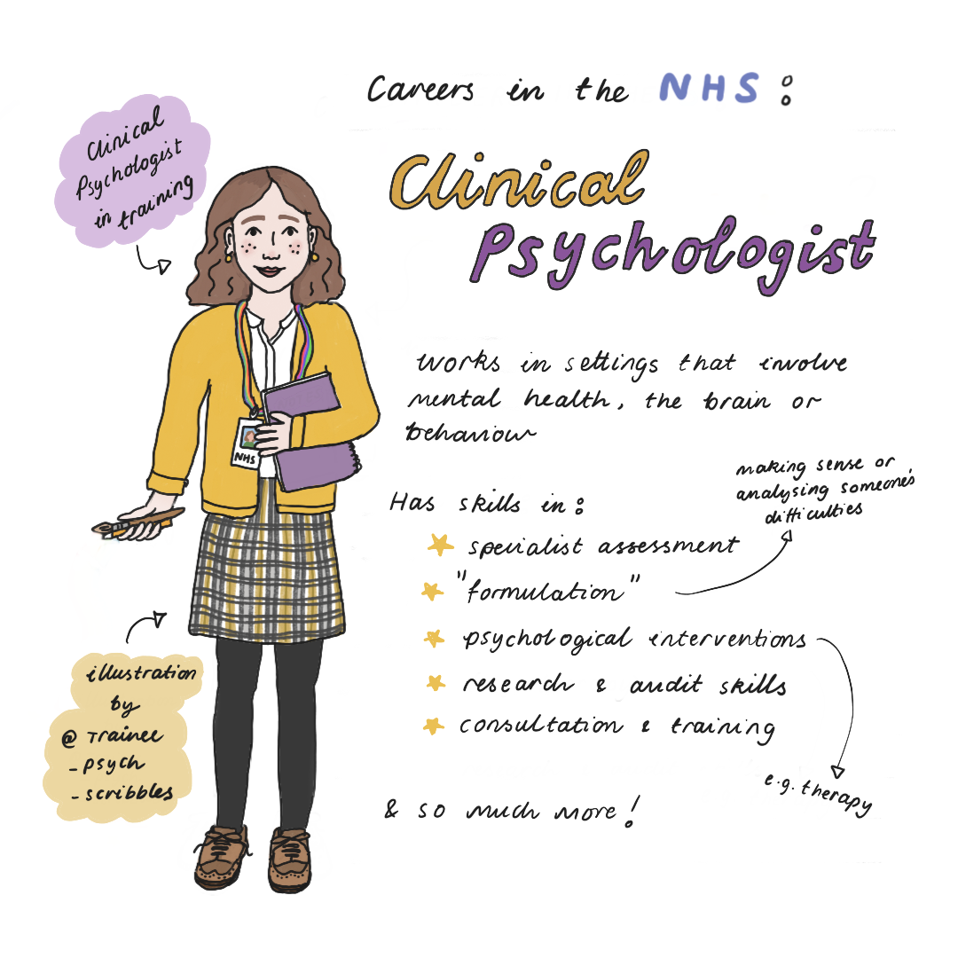

Slide 3
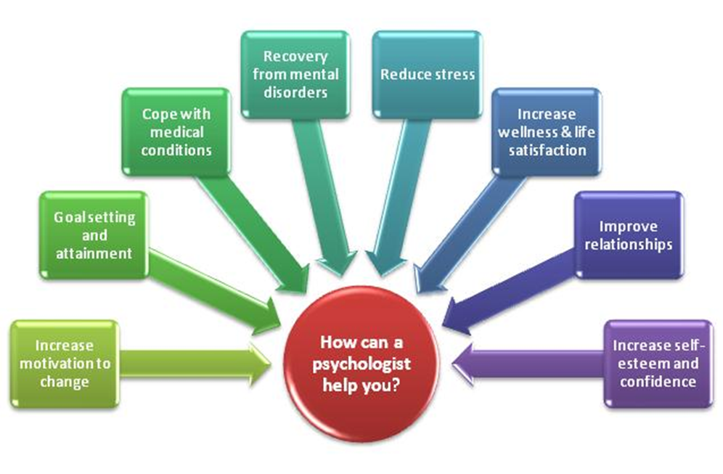

Slide 4
Skills acquired through studying psychology at undergraduate level
Knowledge and understanding of human behaviour
Analytical problem solving
Effective communication
Teamwork
Scientific method and reasoning
Critical thinking
Ethical judgement

Slide 5
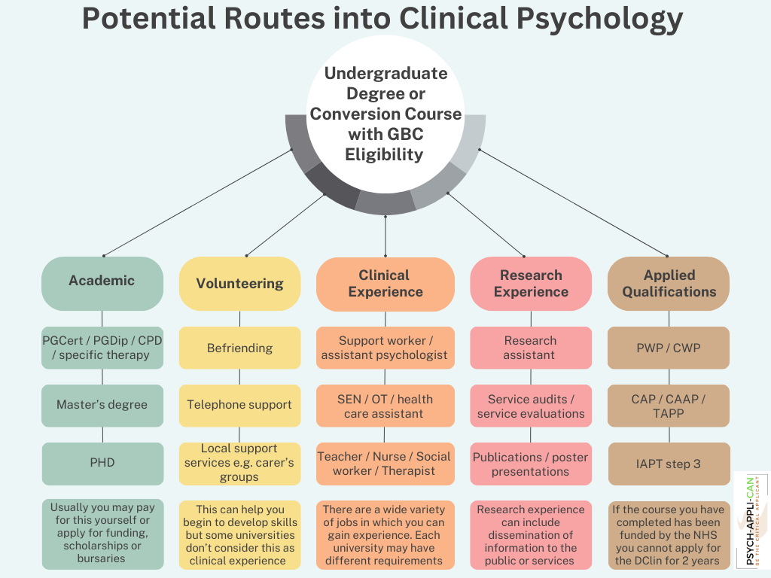

Slide 6
Clinical Psychology training
Doctorate in Clinical Psychology (DClinPsy) is the primary route to becoming a clinical psychologist.
The programme typically takes three years and combines academic learning with practical placements in various clinical settings.
Institutions like Trinity College Dublin, University College Dublin, and University College Cork offer accredited DClinPsy programmes in RoI.
Queens University Belfast delivers Clinical Psychology training for the HSC in N. Ireland
Clearing House system in UK for access to courses in England, Scotland and Wales.
Courses approved by Health & Care Professions Council (HCPC) and accredited by BPS

Slide 7
Why Clinical Psychology training?
Increased recognition of importance of psychological wellbeing
Increased funding for services and training places
Growth in family of psychological practitioners
Supervision & mentoring
Leadership consultation & governance

Slide 8
Why Clinical Psychology training in N. Ireland?
High level involvement of Clinical Psychologists in the region
Placements available in full range of specialist clinical settings across all Trust areas
Core therapeutic modalities and specialist pathways
Self care, self awareness and reflective practice
Research publication rate

Slide 9
Successful applicants
Relevant experience
Applying psychological theory to real world problems
Scientist practitioner
Good communication skills
Good listener
Empathic
Reflective
Self-awareness
Analytical
Problem solving

Slide 10
Successful applicants?
60-70% are 25-30 years of age
80% are female
50% QUB / UU graduates
50% NI is country of birth
80% have worked as AP
80% have Masters
15% PhD

Slide 11
Importance of Application form…
Demonstrate learning acquired through studying psychology
Evidence growth & learning acquired through undertaking relevant work experience
Evidence research skills & competence
Avoid Spelling / grammatical errors
Demonstrate good presentation skills & focus
Graduate basis for chartered membership (GBC)

Slide 12
Advice you would give to candidates?
Motivation – why clinical psychology?
Reflect – what would I bring to the role?
Readiness – why now?
Aptitude – why am I suitable?
Personal qualities (resilience, managing competing demands)?
Clear demonstration of competencies?
Previous applications?

